Slide 1

Customer Acquisition Cost (CAC) Analysis

Slide 2
About me :
Name : B.Sai Rohit
Graduation : B.Tech (CSE)
Email : sairohitbasantam15@gmail.com
I want to learn data science to understand how data impacts businesses.

Slide 3
Problem Statement
Analyze and optimize Customer Acquisition Cost (CAC) across different marketing channels to improve cost efficiency and maximize customer growth.

Slide 4
Objective of The Project
To analyze Customer Acquisition Cost (CAC) across various marketing channels and derive insights to optimize spending, improve cost efficiency, and maximize customer growth

Slide 5
Introduction
What is CAC?
The cost incurred to acquire a new customer.
Key metric for profitability and growth.
Why is CAC Important?
Helps optimize marketing strategies.
Ensures sustainable business growth.

Slide 6
CAC Analysis Process
Steps :
1. Collect relevant customer acquisition data.
2. Segment costs by marketing channels.
3. Identify key CAC metrics.
4. Calculate CAC for each channel.
5. Analyze and optimize costs.

Slide 7
Dataset Overview
Dataset Details:
Customer_ID : Unique identifier.
Marketing_Channel : Channel used for acquisition.
Marketing_Spend : Amount spent.
New_Customers : Number acquired.
Summary:
500 records, 4 channels, No missing values.

Slide 8
Data Preprocessing
Checked for:
Null values
Duplicate records
Inconsistent data
Standardized column names and ensured data integrity.

Slide 9
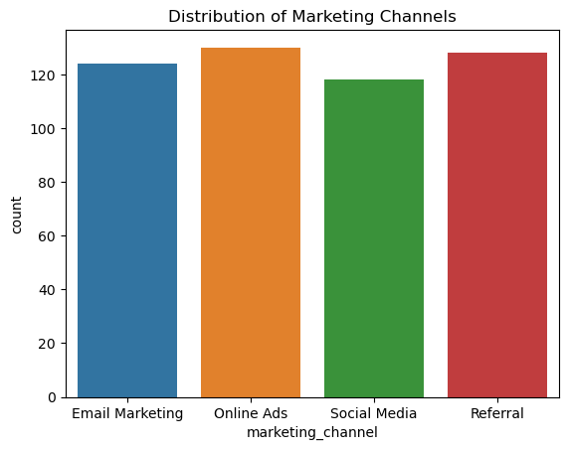
Univariate Analysis
Graph : Bar plot showing marketing channel distribution.
Most acquisitions from Online Ads.
Social Media & Email Marketing contribute significantly.
Social Media has the least acquisitions.

Slide 10
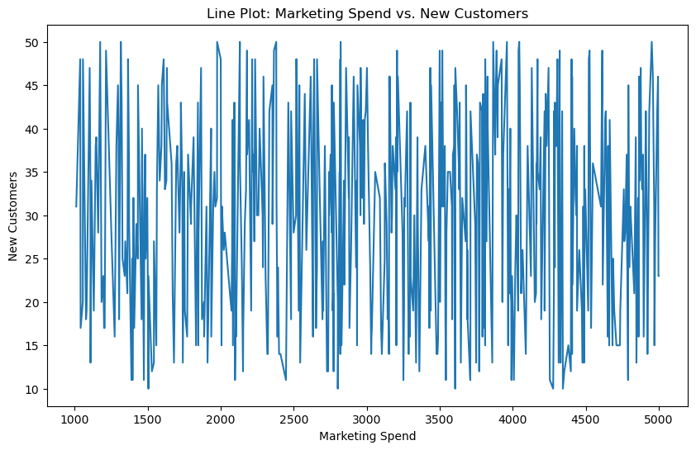
Bivariate Analysis
Graph : Line Plot of Marketing Spend vs. New Customers.
Positive correlation : Higher spending generally leads to more customers.
Fluctuations observed : Diminishing returns at higher spending levels.
Optimization needed: Identify cost-effective spending limits.

Slide 11
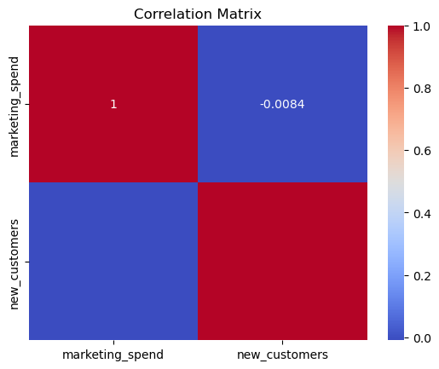
Multivariate Analysis
Graph : Correlation Heatmap.
Strong correlation between Marketing Spend and New Customers.
CAC inversely related to new customers.
Marketing channels impact conversion rates differently.

Slide 12
CAC Calculation & Insights
Formula : CAC = Marketing Spend / New Customers
Findings :
Email Marketing : Highest CAC (~132.91)
Referral : Lowest CAC (~119.89)
Negative trend in Scatter Plot suggests efficiency.

Slide 13
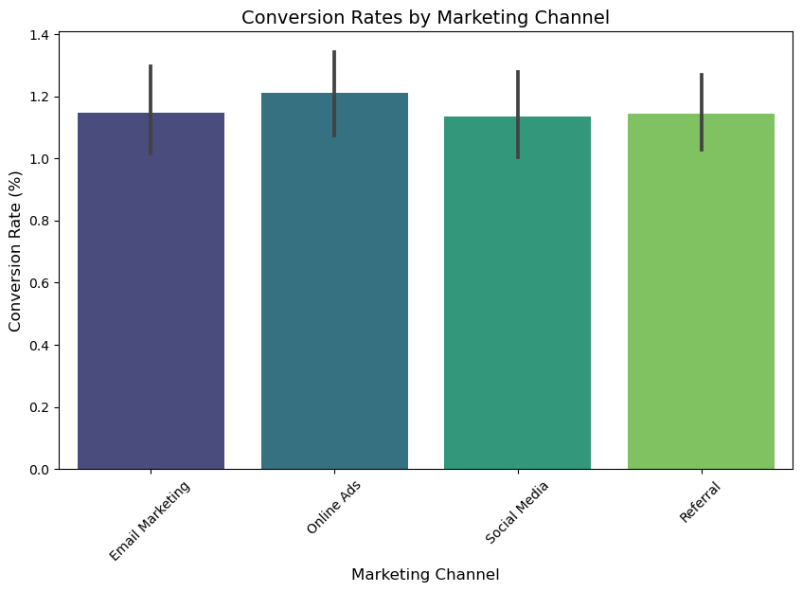
Conversion Rate Analysis
Formula:
Conversion Rate = (New Customers / Marketing Spend) * 100
Findings:
Online Ads have the highest conversion rate.
Other channels have moderate conversion rates.

Slide 14
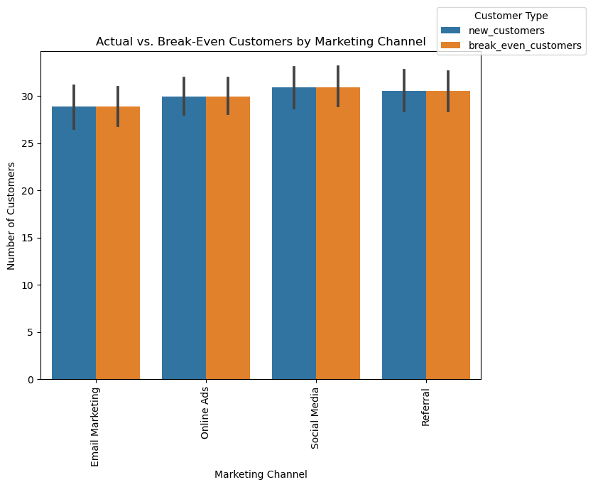
Break-Even Analysis
Definition : Customers needed to cover marketing costs.
Formula : Break-even Customers = Marketing Spend / CAC
Key Insights :
Actual new customers match or slightly exceed break-even customers.
Marketing spend is well-optimized with no major losses.
Further cost reductions can enhance profitability.
Graph: Shows balanced acquisition across all channels.

Slide 15
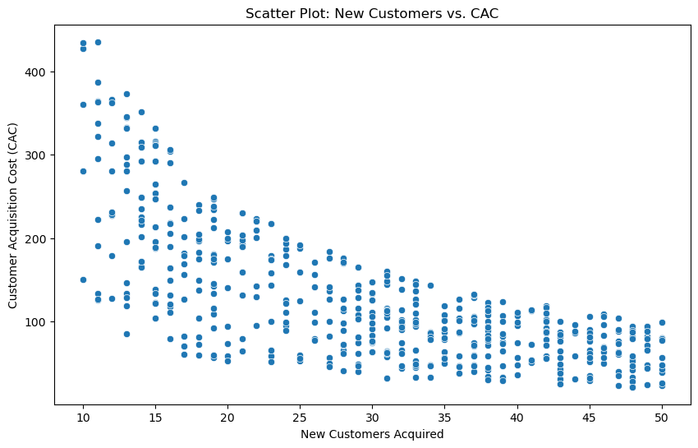
Impact of Customer Growth on Acquisition Cost
As new customers increase, CAC decreases, indicating economies of scale and lower per customer costs.
Scaling the customer base improves cost efficiency, reducing overall acquisition expenses.

Slide 16
Key Insights
Email Marketing has the highest CAC.
Referral Marketing is the most cost-effective channel.
Online Ads show the highest conversion rates.
CAC optimization strategies enhance efficiency.

Slide 17
Conclusion
Marketing Spend Optimization : Online Ads and Referral Marketing offer better customer acquisition efficiency.
Cost-Effectiveness : Referral Marketing has the lowest CAC, making it the most cost-effective channel.
Insights from Data Analysis : The negative trend in the CAC scatter plot indicates that increasing customer acquisition can reduce overall costs.
Business Recommendation : Companies should focus on high-conversion channels while optimizing spending on costlier ones like Email Marketing.

Slide 18

Questions & Answers
Feel free to ask any questions regarding the analysis!

Slide 19


THANK YOU

